Slide 1

Unlocking Interviews
Reading Between the Lines

Slide 2
“
What are you looking for?
(What is the purpose of the question? What would the answer you expect be?)

Slide 3
“
Open-ended questions
(Non-binary responses!
Look for stories and narratives)

Slide 4
“
Example-specific questions
(When was the last time this happened...?
Could you illustrate an example of this?)

Slide 5
“
Collecting evidence
(quotes; observations; false starts)

Slide 6
“
Being cognizant of deflection / avoidance
(can you ask follow up questions? Can you pursue this discussion?)

Slide 7
“
Questions anchored in research or discussion
(You said this, could you expand further?)

Slide 8
“
Questions for collective good of the cohort

Slide 9
“
Get stories and narratives from your panelists

Slide 10
“
Context of the setting
(can you ask follow up questions? Is there a facilitator?)

Slide 11
Summary
What are you looking for?
Open-ended Questions
(How do you go about checking the quality of data?)
Example specific Questions
(When was the last time this happened?)
Context of Setting
(Are you able to ask follow up questions? Do you use a facilitator)
Collect
Evidence
(Quotes, Observations, Behaviours)
Cognizant of Deflections
Questions anchored in discussion
(You said this, could you expand on it further)
Questions for the Collective Benefit
Of the group
Get Stories from the narratives not just information
Research the Panelists
(Study Panelist Responses)

Slide 12
Data Profile

Slide 13
Data Profile
Stakeholders

Slide 14
Data Profile
Stakeholders
Scenarios
Typical
(normal)
Almost typical
(common)
Atypical
(fringe)

Slide 15
Data Profile
Stakeholders
Scenarios
Limits
Typical
(normal)
Almost typical
(common)
+
In scope
Other data
Atypical
(fringe)

Slide 16
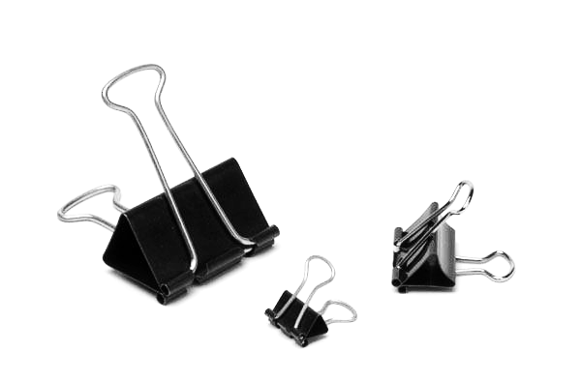
Paper Clip

Slide 17

Typical use
Typical Use

Slide 18
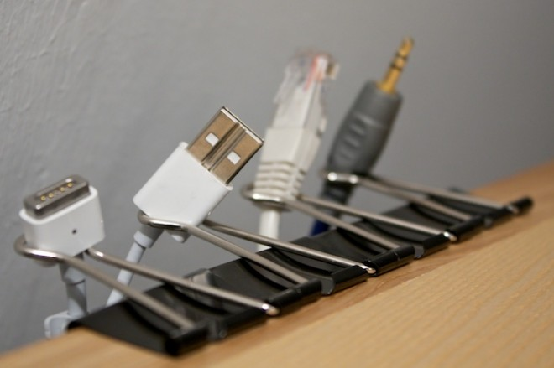
Atypical Use

Slide 19
Atypical Use
How do you get from
A typical use to atypical use?

Slide 20
Example:
Q. What is your biggest challenge?
A. Our biggest challenge is the sheer volume of data

Slide 21
Example:
Q. What is your biggest challenge?
A. Our biggest challenge is the sheer volume of data

Slide 22
Example:
Q. What is your biggest challenge?
A. Our biggest challenge is the sheer volume of data
What does the data look like?
How is it collected?
Who owns it?
Who is responsible for it?
How is it maintained?
Where is it stored?

Slide 23
Example:
Q. What is your biggest challenge?
A. Our biggest challenge is the sheer volume of data
Why is this the biggest?
Who decides its priority?
Is it related to targets?

Slide 24
Example:
Q. What is your biggest challenge?
A. Our biggest challenge is the sheer volume of data
Does the infrastructure not support dealing with such large volumes of data?
Is it cleaning up the data after? Is it processing the data?
Does the department not have enough people to manage the data?

Slide 25
Example:
Q. What is your biggest challenge?
A. Our biggest challenge is the sheer volume of data
How much is too much data? 20GB, 20TB? 2000TB?...

Slide 26
Q. What is your biggest challenge?
A. Our biggest challenge is the sheer volume of data
What does the data look like?
How is it collected?
Who owns it?
Who is responsible for it?
How is it maintained?
Where is it stored?
Why is this the biggest?
Who decides its priority?
Is it related to targets?
How much is too much data? 20GB, 20TB? 2000TB?...
Does the infrastructure not support dealing with such large volumes of data?
Is it cleaning up the data after? Is it processing the data?
Does the department not have enough people to manage the data?

Slide 27
What kind of questions to ask?
What
When
What data are you collecting? What are you looking for? What is the underlying assumption?
When is this data important? When is this data collected? When is this data obsolete? When is this data refreshed?
Who
Why
Who are you collecting the data for? Who will use the data? Who already uses the data? Who can use the data? Who will it impact? Who will be interested? Who will be included? Who will be marginalized? Who benefits? Who is disadvantaged?
Why is the data being collected it? Why collecting this data important? Why is it being done this way? Why is it being collected through this way and not another?
Where
How
Where is this data being collected? Where is it being used? Where else can it also be used? Where is it being done differently?
How is it being collected? How can it be done differently? How is the data being used? How else can it be used? How can the data be improved? How can the data collection process be improved? How frequently is it being collected? How long has it been collected for? How long will you keep collecting it? How is it being used? How is it being stored?

Slide 28
Reading between the lines
Inductive
Reasoning
Deductive
Reasoning
Abductive
Reasoning
Specific observation
General rule
Incomplete observations
General conclusion
Specific conclusion
Best inference

Slide 29
Reading between the lines
Inductive
Reasoning
Deductive
Reasoning
Abductive
Reasoning
Specific observation
General rule
Incomplete observations
General conclusion
Specific conclusion
Best inference

Slide 30
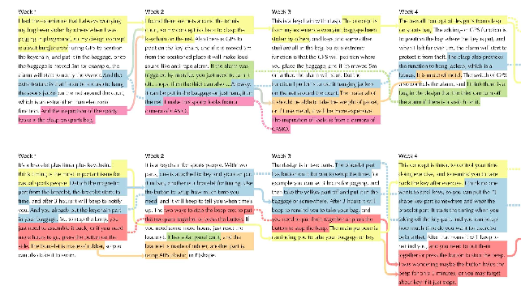
Thematic Analysis
Data
Scenario of use
Limits / Boundary Applications
User

Slide 31
Thematic Analysis
Predefined Themes
New Themes
Data
Scenario of use
New Theme 1
Limits / Boundary Applications
New Theme 2
User
Emergent categories from your data that are interesting and can help you in abductive reasoning
Categories you are already reading the transcript for

Slide 32
Task | Reading between the lines
What is your biggest challenge? “Our biggest challenge is the sheer volume of data”..
What would you like more of?
More data!
Statements:
“We outsource our maintenance”
“Our data centres are cloud based”
“We report our progress to..”
Unpacking responses
What is said and what is inferred?
What is the deep underlying statement?
What else do you need to understand this further?
How would you analyze the findings?

Slide 33
Task | Reading between the lines
What is your biggest challenge? “Our biggest challenge is the sheer volume of data”..
What would you like more of?
More data!
Statements:
“We outsource our maintenance”
“Our data centres are cloud based”
“We report our progress to..”
Unpacking responses
What is said and what is inferred?
What is the deep underlying statement?
What else do you need to understand this further?
How would you analyze the findings?

Slide 34
Task | Reading between the lines
What is your biggest challenge? “Our biggest challenge is the sheer volume of data”..
What would you like more of?
More data!
Statements:
“We outsource our maintenance”
“Our data centres are cloud based”
“We report our progress to..”
Unpacking responses
What is said and what is inferred?
What is the deep underlying statement?
What else do you need to understand this further?
How would you analyze the findings?

